Slide 1
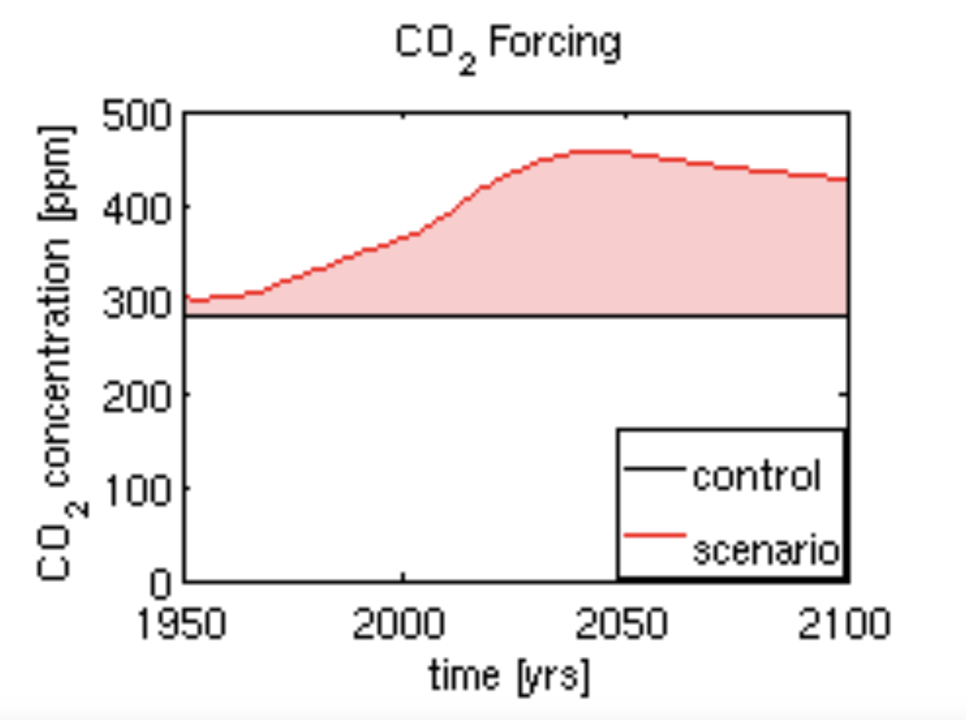
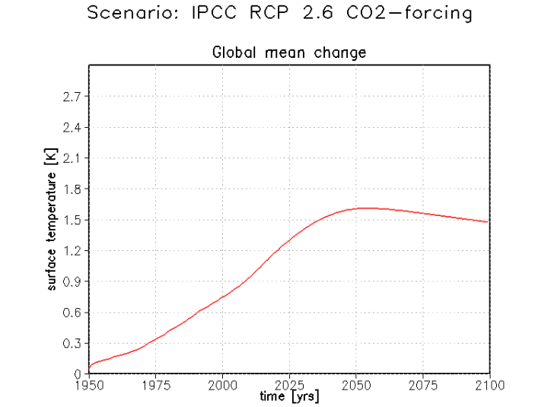


$$∆[CO_{2}]≈420−300 ppm$$
$$∆T≈1.5−0.1 ℃$$
Looks like $CS=\frac{1.5−0.1}{420−300}×290=3.4 \frac{℃}{2×CO_{2}}$

